Slide 1
Image Processing Automated Coin Detection to Estimate the Total Value of the Coins in an Image Using OpenCV
DIALLO Mamadou Yaya Chérif
KANCHERLA Manideep Reddy
M1 – Vision & Machine Intelligente

Slide 2
Index
Introduction
Objectives
Materials & Methodology
2.1. Materials
2.2. Image Processing
2.3. Value Estimation
Results and Discussion
3.1. Results
3.2. Discussion
Conclusion

Slide 3
Introduction
Vital part of society since the ancient times
Shift towards electronic transactions -> Eliminate the tedious task of counting coins
Not limited to coins
Huge array of techniques and approaches: Artificial neural networks, Heuristics approach, sensors etc.
Our Approach: Circular Hough approach using canny edge to detect edges and estimating the coin values based on circle radii

Slide 4
1.Objectives
To implement our approach:
Develop an effective methodology for Circular Hough transform
Develop a method to estimate the coin values using radius of the detected circles
Discover other usable approaches and add further functionalities
Understanding our limitations at the end in order to further optimize our proposed approach

Slide 5
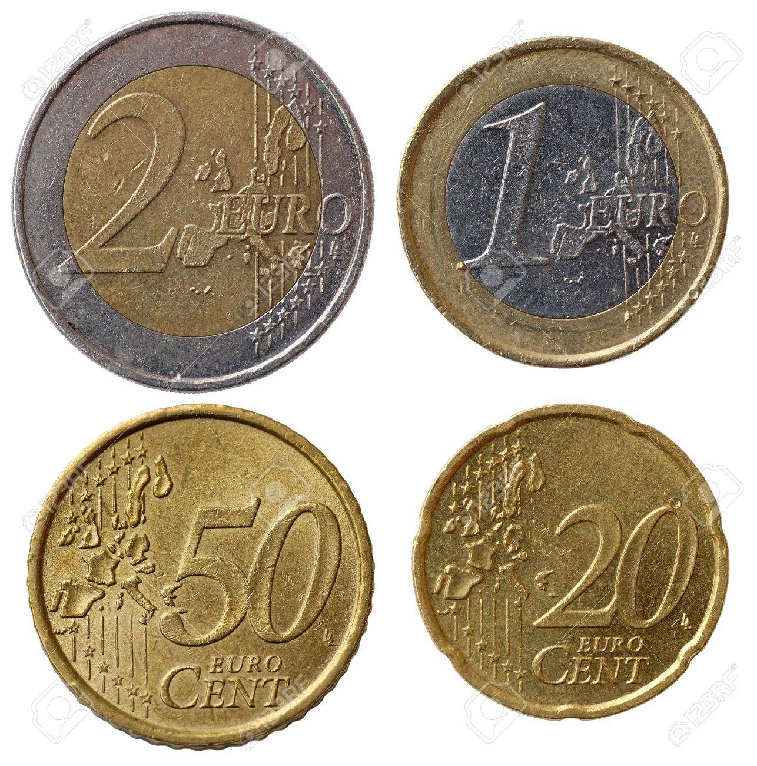
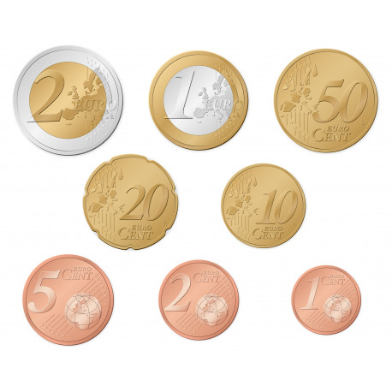
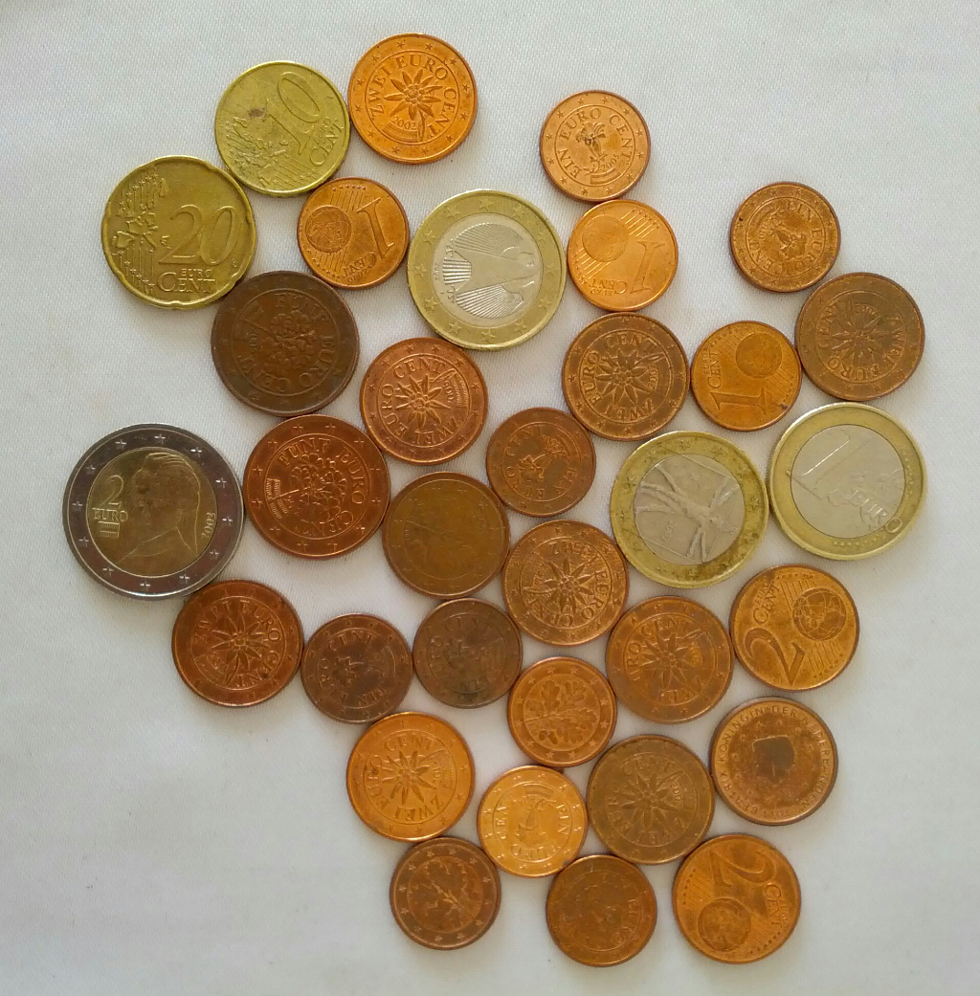
2.1. Materials
2.Materials and Methodology
Laptop Specifications:
AMD Ryzen 7 4800H with Radeon Graphics 2.90 GHz
16,0 GB RAM (15,4 GB usable)
IDE: Visual Studio using OpenCV
Language: C++
Three different images with an increasing number of coins in each image
Methodology demonstrated using the cleanest image with 8 coins
Figure 1: Images used to implement our approach

Slide 6
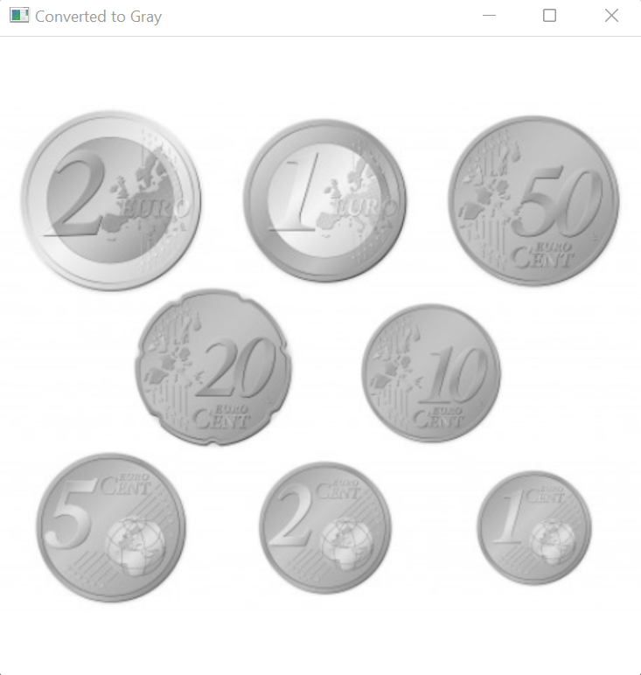

2.2. Image Processing
2.Materials and Methodology
Convert to Gray
To simplify the algorithm and computational demands by providing less information for each pixel
Median filtering
To filter out noise and smoothen the image by using the median of the neighbouring pixels
Figure 2: Image converted to gray
Figure 3: Image after median filtering

Slide 7
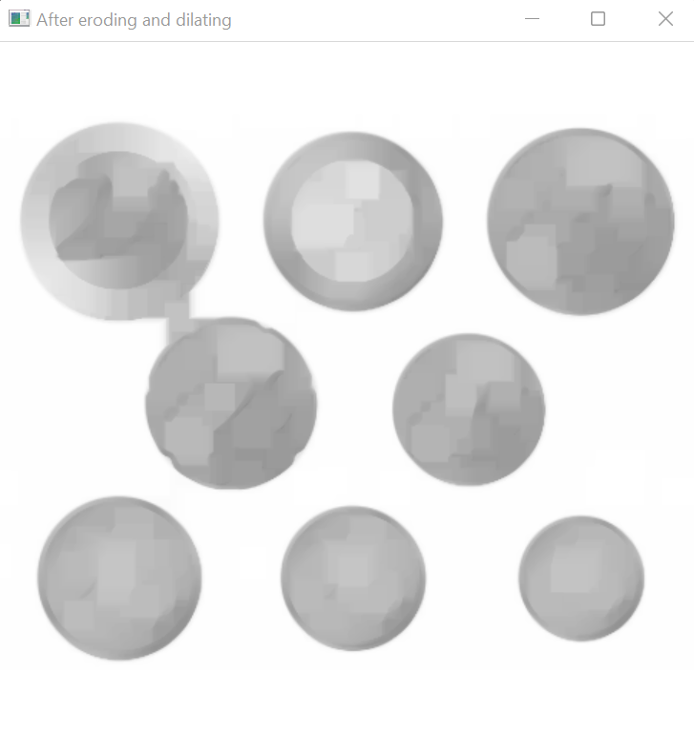
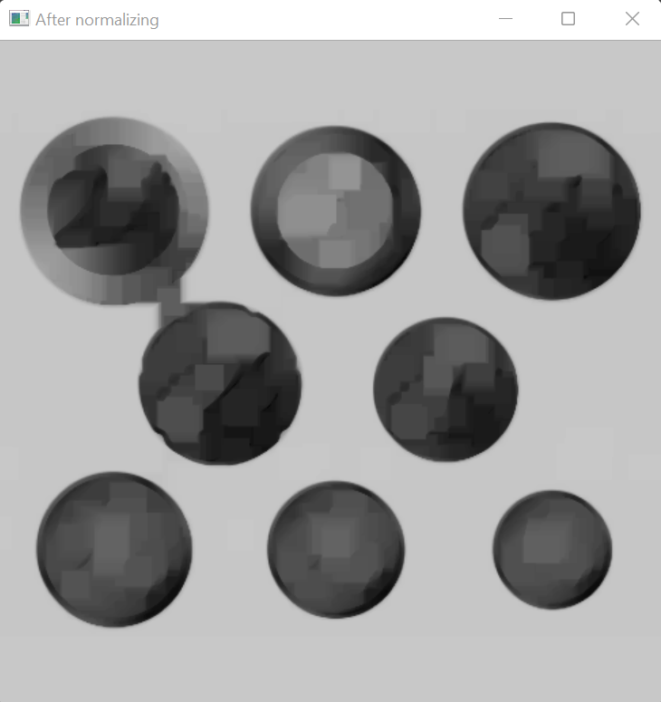
2.2. Image Processing
2.Materials and Methodology
Morphological operation to process images based on shapes
Erosion: Erodes the boundaries of the foreground object and diminishes the features of an image
Dilation: Increases the object area and accentuates the features
Normalization
To change the intensity level of pixels and get a better contrast in images
Figure 4: Image after Morphological operations
Figure 5: Image after Normalization

Slide 8
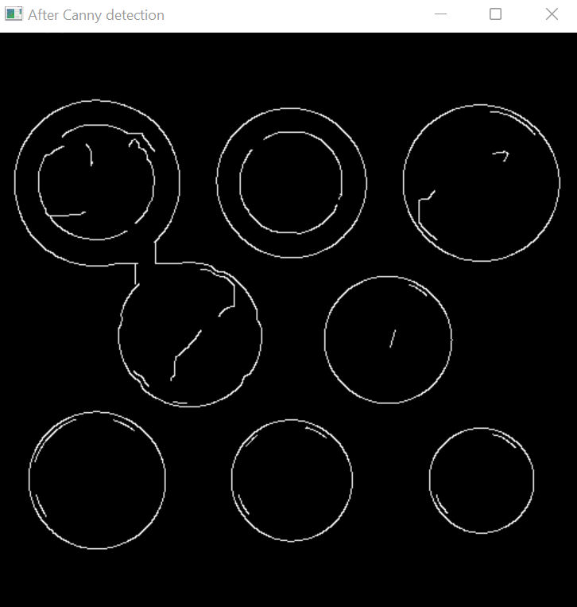
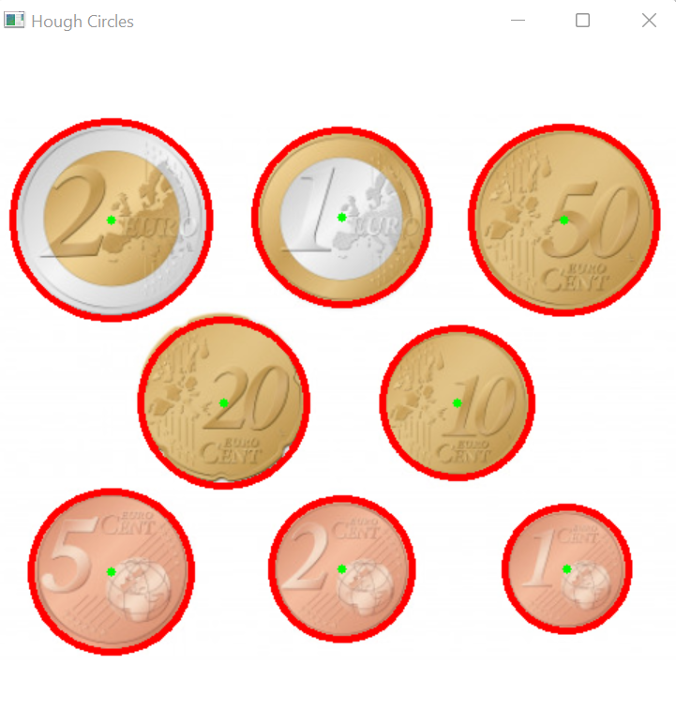
2.2. Image Processing
2.Materials and Methodology
Canny Edge Detection
Developed by John F. Canny in 1986, it is an edge detection operator that uses a multi-stage algorithm to detects wide range of edges
Circular Hough Transformation
Used to find circles in an image and is represented by it’s centre and radius r of the circle
Figure 6: Image after Canny detection
Figure 7: Image after Circular Hough transformation

Slide 9
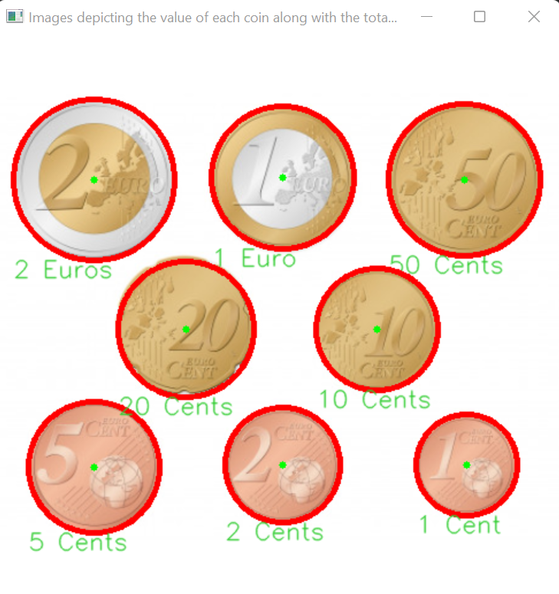
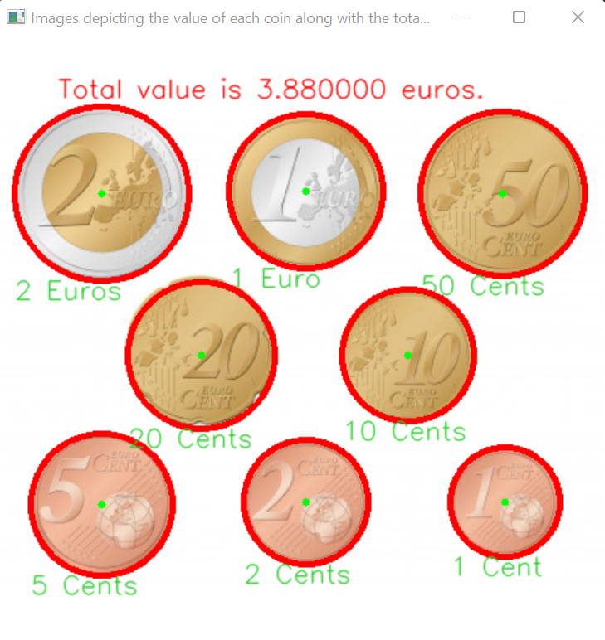
2.3. Value Estimation
2.Materials and Methodology
Value detection using the circle radius:
Identify the coin with the highest diameter
Use real life measurements to calculate the ratio between diameters of any given coin and the one with the highest diameter
Compare the real life ratios with ratios computed using the processed image in order to the detect the coin value for each of the detected circles
Finish by displaying the coin values on the original image
Displaying the total value of coins on the screen
Figure 8: Detecting the value of each coin
Figure 9: Detecting the total value

Slide 10
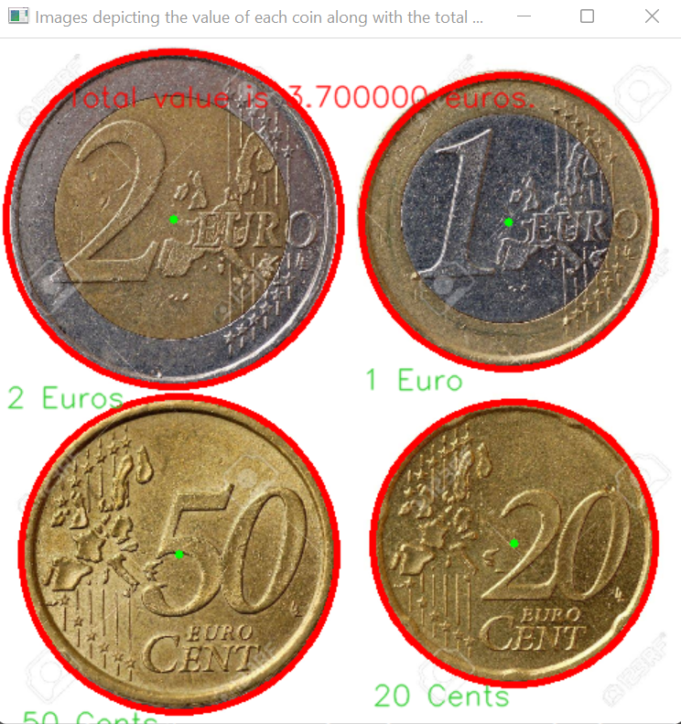
3.1. Results
3.Results and Discussion
Figure 10: Results – Image with smaller number of coins (500x500)
Figure 11: Image with the medium number of coins (490x490)

Slide 11
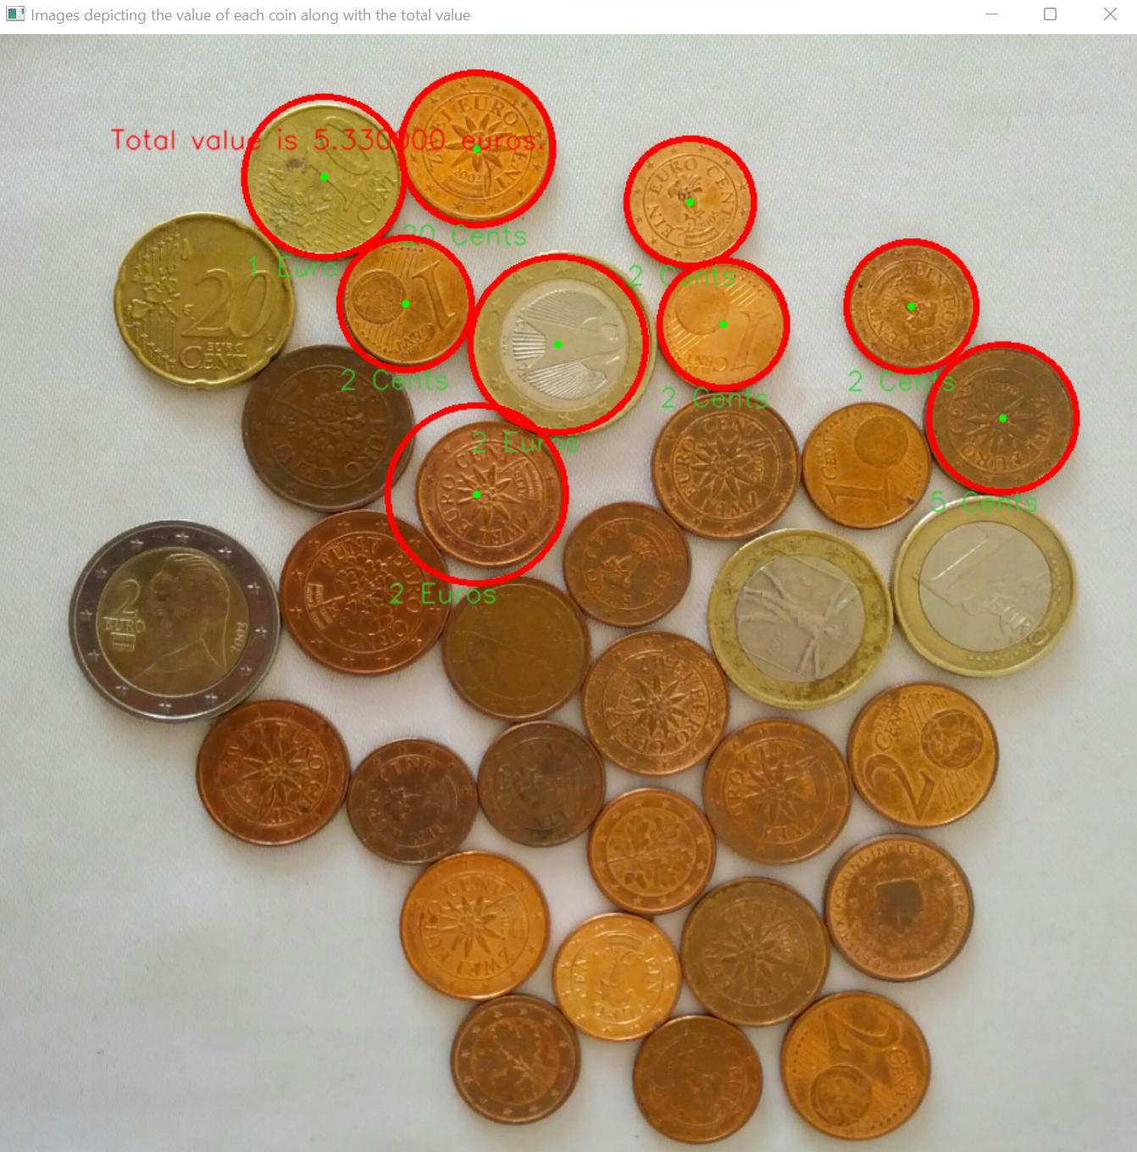
3.2. Discussion
3.Results and Discussion
Image with large number of coins experiencing difficulties
This may be due to:
Resolution of the image
Coins too close to each other
Difficulty in doing image processing
Figure 11: Image with the most number of coins (900x900)

Slide 12
Conclusion
Elaborate a methodology to detect coins with the Circular Hough approach using canny edge detection and identifying the coin values using the radius of Hough circles
Identify limitations in detecting coins on an image containing large number of coins stacked together
Future work in the direction of addressing the limitations and testing more use cases, along with working with other coin detection approaches using neural networks, sensors etc.

Slide 13
Thank You For Your Attention !!!

